Slide 2
Object Literals and the Brackets Notation
One can use both dot notation and brackets notation
var car = {}; car.color = "red";car["color"] = "green";
Note that using the brackets notation, I essentially just wrap each property's key as a string,

Slide 3
Arrays are Objects
One of the most commonly used built-in methods on arrays are the push() and the pop() methods fruits.push("apple"); // ['apple']
I can now call the arrayBuilder() function, arrayBuilder('apple', 'pear', 'plum'); // ['apple', 'pear', 'plum’]
Additionally, I can save this function call to a variable. var simpleArr = arrayBuilder('apple', 'pear', 'plum');

Slide 4
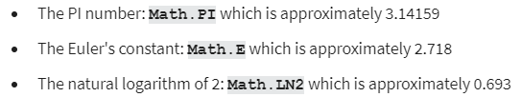
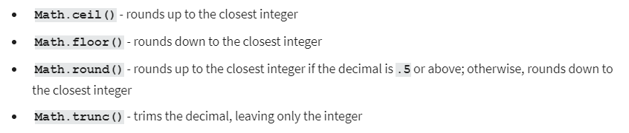
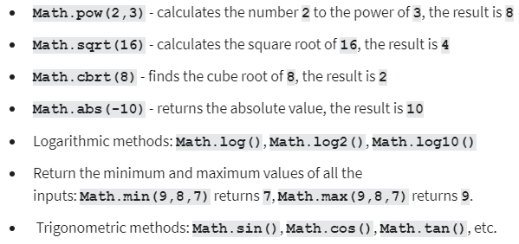
Math object cheat sheet

Slide 5
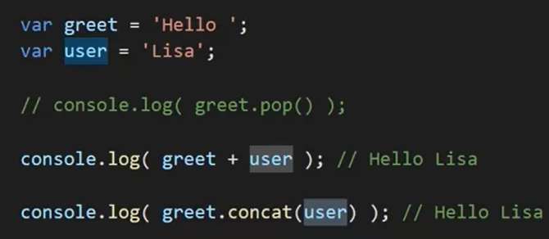
String concatenation

Slide 6
String cheat sheet
var greet = "Hello, ";
var place = "World"
greet.length;
greet.charAt(0); // 'H’
"Wo".concat("rl").concat("d"); // 'World’
"ho-ho-ho".indexOf('h'); // 0
"ho-ho-ho".split("-"); // ['ho', 'ho', 'ho']
greet.toUpperCase(); // "HELLO, "

Slide 7
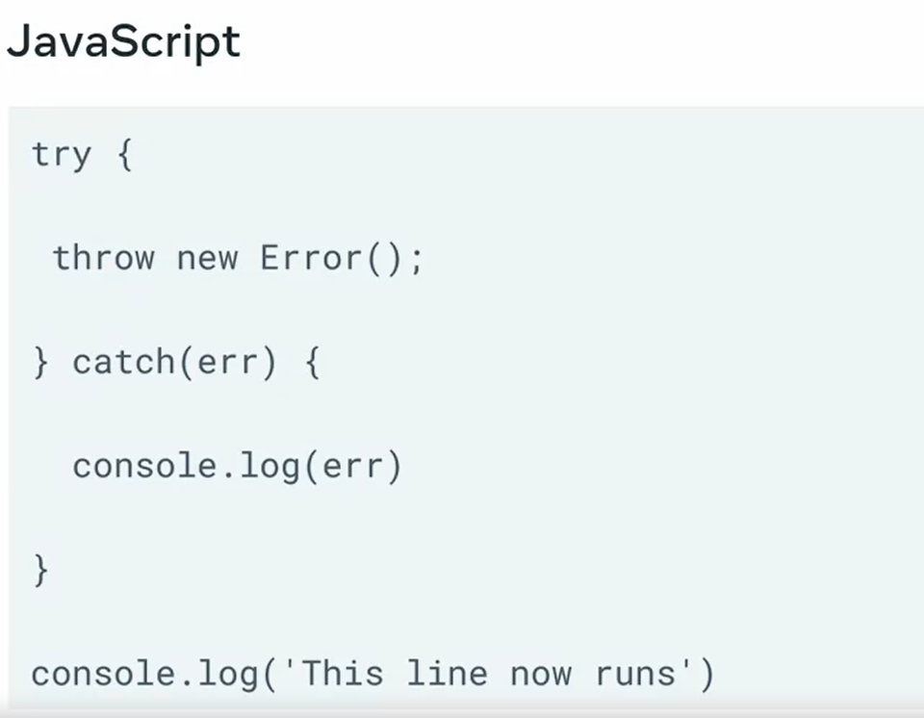
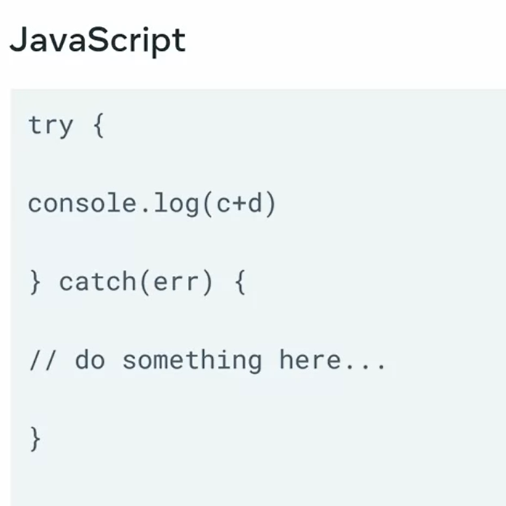
Error handling
Code in try after throw new error will not be executed; it will go to catch instead

Slide 8
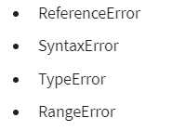
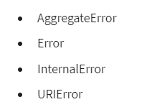

Slide 9
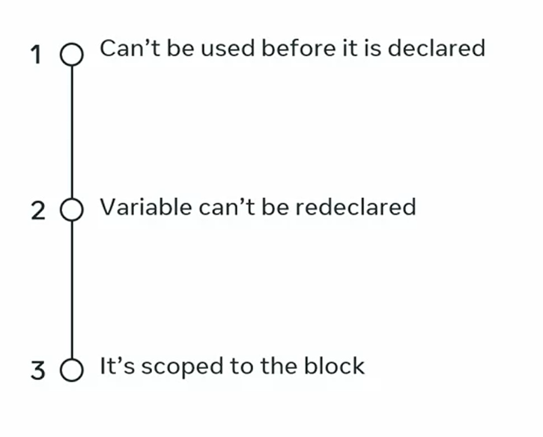
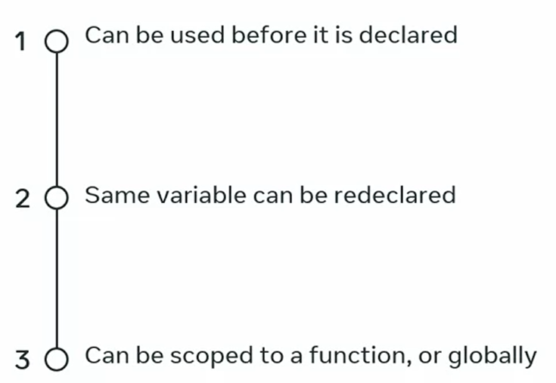
Var let const

Slide 10
OOP
Inheritance
Encapsulation
Abstraction
polymorphism

Slide 11

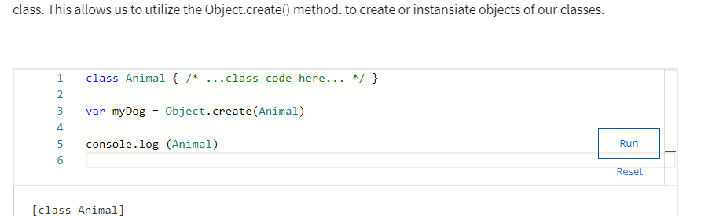
Object.create(className)
Create new object of a class
more common method of creating obbjects from classes is to use the new keyword.

Slide 12

Inheritance
To setup the inheritance relation between classes in JavaScript, I can use the extends keyword, as in class B extends A.

Slide 13
Encapsulation
In the simplest terms, encapsulation has to do with making a code implementation "hidden" from other users, in the sense that they don't have to know how my code works in order to "consume" the code.
I don't really need to worry or even waste time thinking about how the toUpperCase() method works. All I want is to use it, since I know it's available to me.

Slide 14
Abstraction
Abstraction is all about writing code in a way that will make it more generalized.
An abstraction is about extracting the concept of what you're trying to do, rather than dealing with a specific manifestation of that concept.
Encapsulation is about you not having access to, or not being concerned with, how some implementation works internally.

Slide 15
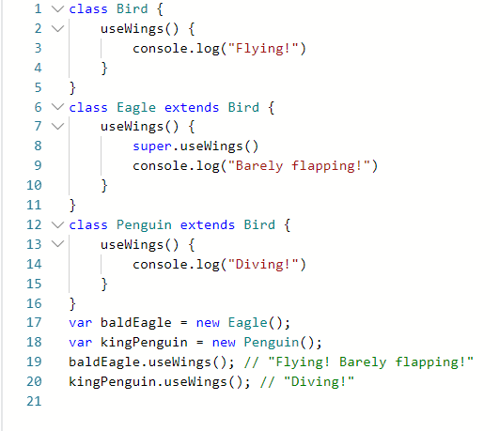
Polymorphism
Polymorphism is a word derived from the Greek language meaning "multiple forms". An alternative translation might be: "something that can take on many shapes".
The Penguin and Eagle sub-classes both inherit from the Bird super-class. The Eagle sub-class inherits the useWings() method from the Bird class, but extends it with an additional console log. The Penguin sub-class doesn't inherit the useWings() class - instead, it has its own implementation, although the Penguin class itself does extend the Bird class.

Slide 16
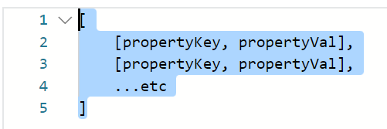
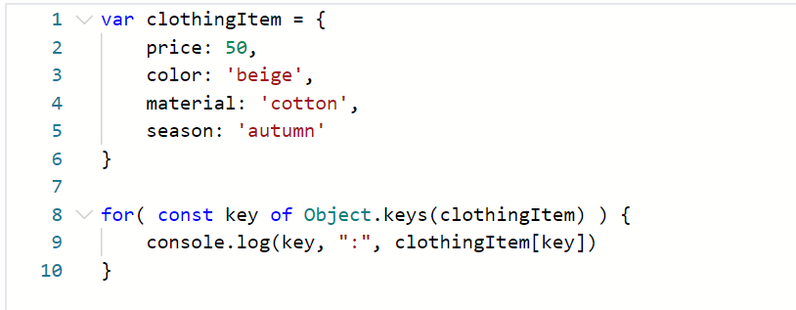
Loop an object
Object.entries()

Slide 17
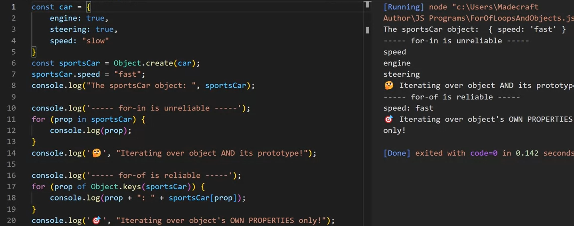
For-of vs for-in
For-of: only the object properties
For-in: object and its prototype

Slide 18
Template literals
console.log(`${greet} ${place} !`)//placeholder by ${}
template strings can span multiple lines.
//it's possible to perform arithmetic operation inside a template literal expression console.log(`${1 + 1 + 1 + 1 + 1} stars!`)

Slide 19
4 common JS data structures
Object
Array
Map
Set

Slide 20
Working with arrays in JavaScript
forEach
filter
map

Slide 21
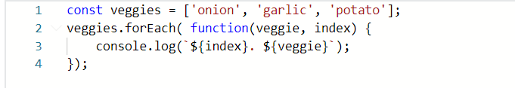
forEach

Slide 22
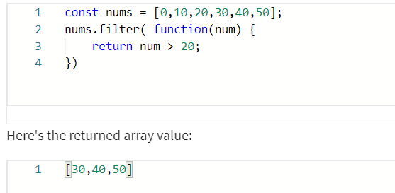
filter

Slide 23
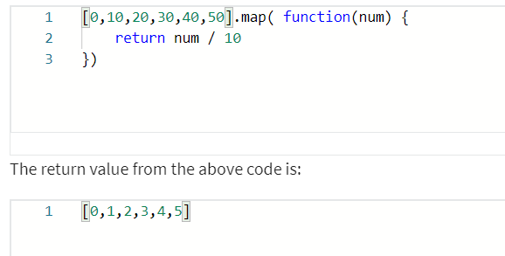
map

Slide 24
Working with Objects in JavaScript

Slide 25

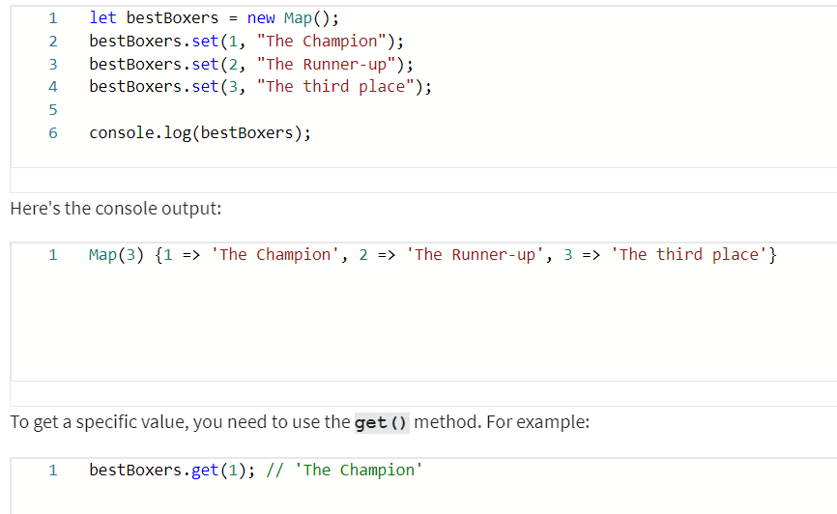
Working with Maps in JavaScript

Slide 26

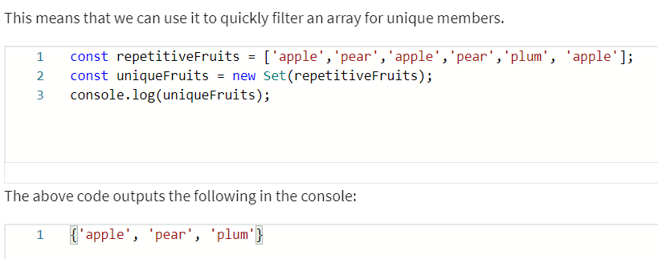
Working with Sets in JavaScript

Slide 27


Spread operator
Alternatively, using spread operation

Slide 28
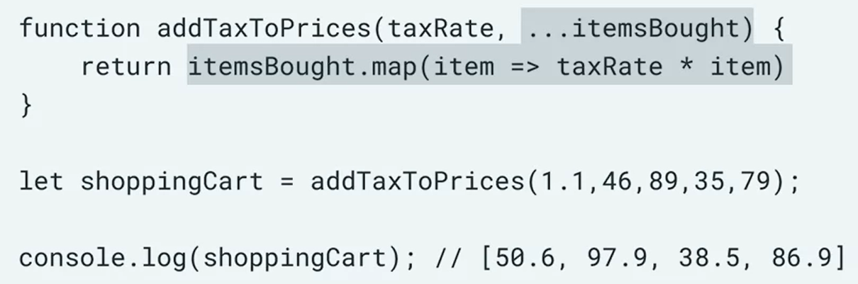
Rest operator

Slide 29
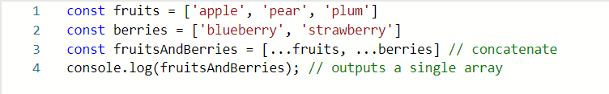

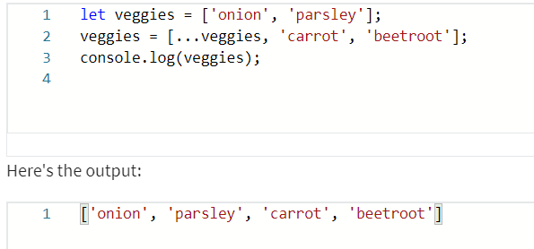
Join arrays, objects using the rest operator

Slide 30

Add new members to arrays without using the push() method

Slide 31
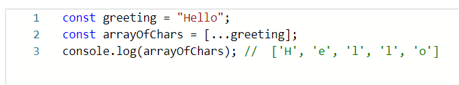
Convert a string to an array using the spread operator

Slide 32
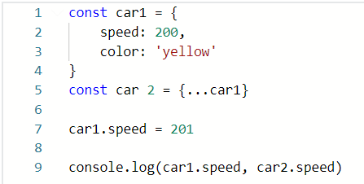
Copy either an object or an array into a separate one

Slide 33
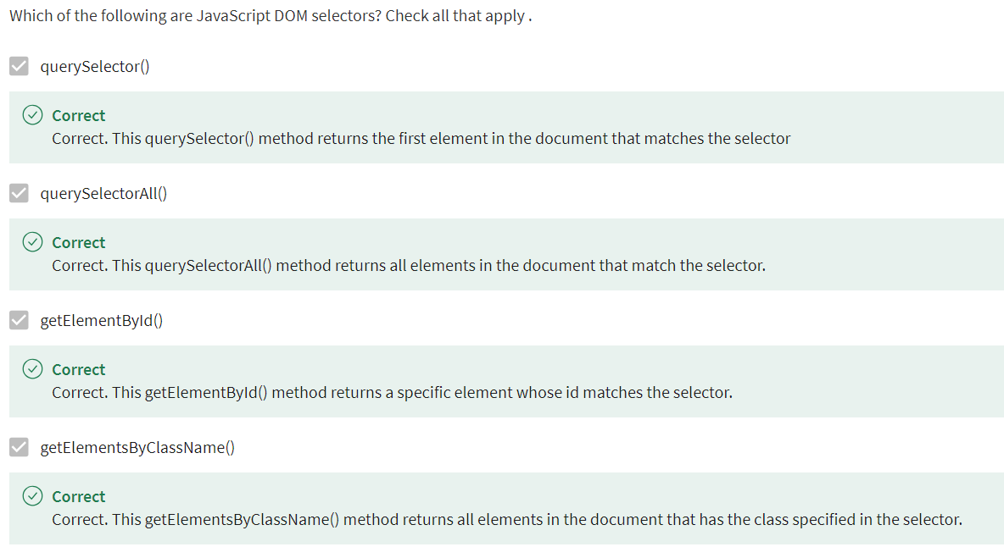
JS DOM Selectors DOM = document object module

Slide 34
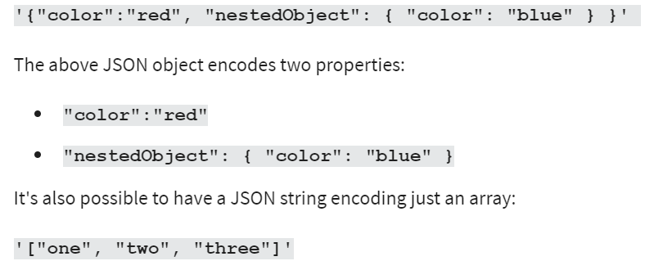
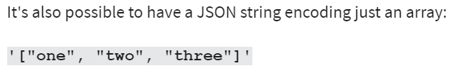
JSON examples

Slide 35
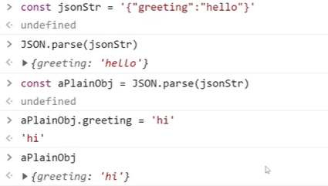
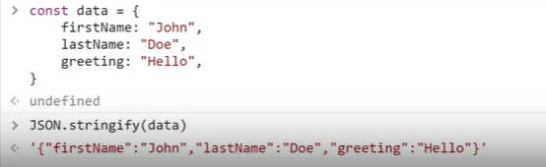
JSON string to JS objects
JS objects to JSON string

Slide 36



Jest
Npm init –y //install package
Npm install –save-dev jest // install jest
In “package.json” file, change
Npm run test

